Slide 1
Cellular Neural Networks and Visual Computing
Leon O. Chua and Tamás Roska
Presentation by
Max Pflueger

Slide 2
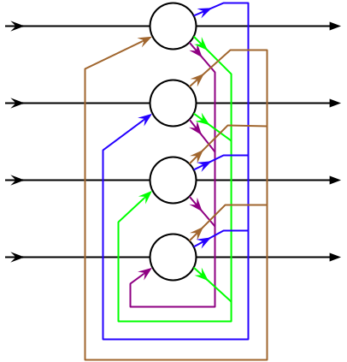
Hopfield Networks
Every node receives input from every other node
Recurrent behavior
Cellular Neural Networks are a variant on Hopfield Nets

Slide 3
Why CNNs?
Hopfield nets are powerful, but because they are fully connected, they are difficult to implement in hardware for a significant number of nodes
CNNs offer a compromise by only connecting nodes to other nodes nearby
CNNs with thousands of nodes can be implemented on a single chip

Slide 4
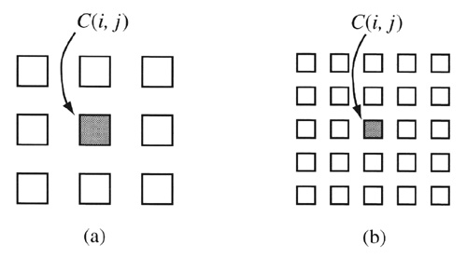
CNNs
Cells are typically arranged in a grid layout
  N rows, M columns
Cells are only connected to other cells within a sphere of influence of radius r
  Note that if r >= max{N,M}-1 we have a Hopfield Net
neighborhood with r = 1
r = 2

Slide 5
CNN Cells
CNN cells are governed by the equation shown below
  x_{ij} is the state of cell (i,j)
  y_{kl} is the output of cell (k,l)
  u_{kl} is the input to cell (k,l)
  z_{ij} is the threshold of cell (i,j)
  C(i,j) is the set of cells in the CNN
  S_{r}(i,j) is the set of cells in the sphere of influence of cell (i,j)
  A(i,j; k,l) and B(i,j; k,l) are the feedback and input synaptic operators respectively

Slide 6
Templates
A and B are not necessarily space and time invariant, but in most applications they can be treated that way
When A and B are space and time invariant, they can be represented by a (2r +1) x (2r+1) matrix
These two matrices, combined with the value for z_{ij} is the template for a CNN

Slide 7
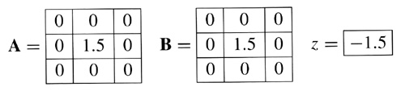
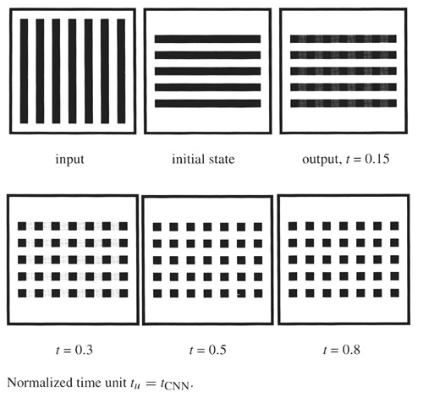
Logical AND Template
This template creates the pixel wise AND of the initial state and the input
The progression of images shows the input and initial image, followed by the output at a series of times

Slide 8
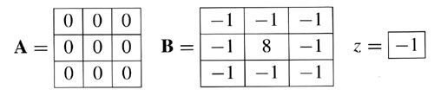
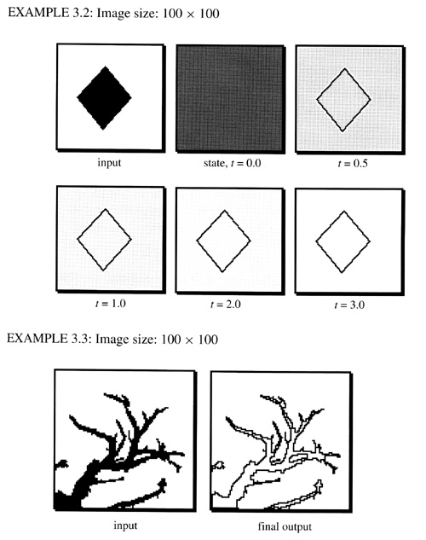
Edge Detecting Template
The template shown at right is designed to show the edges of the input with black pixels
The top example shows the progression through time of the CNN
The bottom shows behavior on a more complex image

Slide 9
The CNN Universal Machine
A CNN can be designed to change templates during operation
A set of templates can be strung together, creating the ability to program the CNN
  This effect is similar to having a CNN with multiple layers
The CNN UM can be programmed in a way very similar to a traditional microprocessor
  Instructions: load template, execute template, etc.

Slide 10
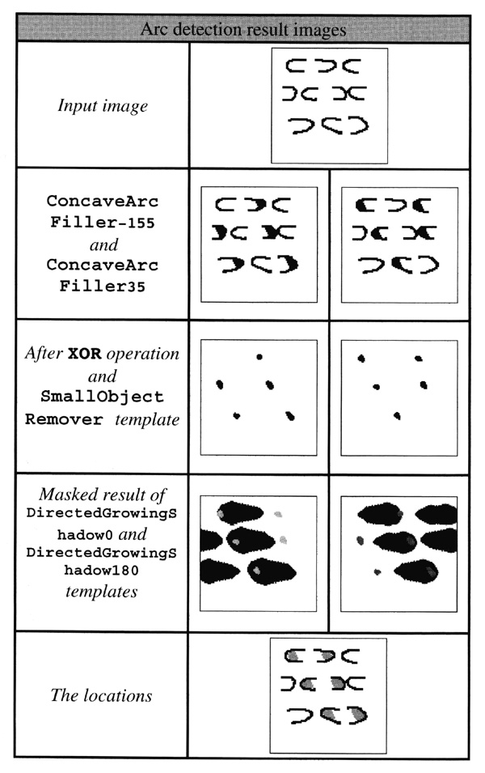
A CNN UM Example
The algorithm at right is designed to identify concave arcs positioned face to face horizontally in relation to each other
The image is transformed by a series of different templates, rather than a single one

Slide 11
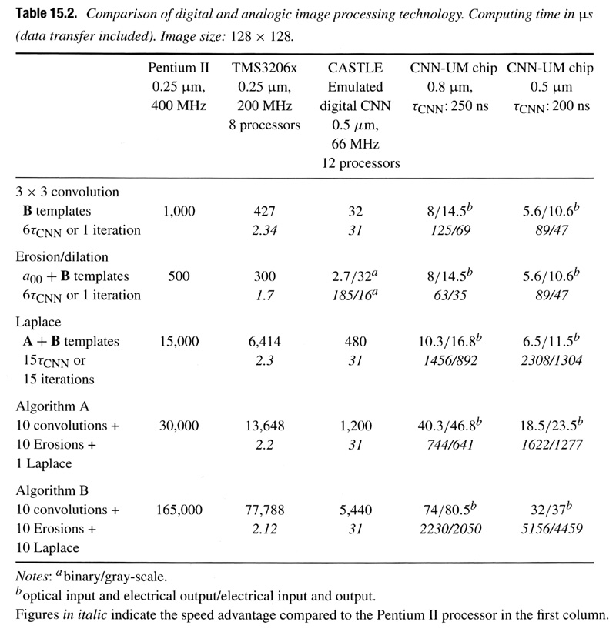
Comparison of Processing Speed
This chart shows a comparison of traditional microprocessors to a couple of different CNN chips in a series of image processing tasks

Slide 12
Questions?

Slide 13
References
Chua, Leon O. and Tamás Roska. Cellular Neural Networks and Visual Computing. Cambridge: Cambridge University Press, 2002.

